Slide 1
Charge Transfer Collisions & My Road to PhD
Dwayne C. Joseph

Slide 2
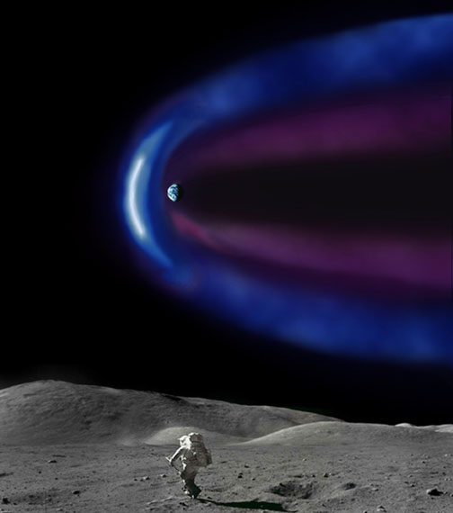
Neutral species
Solar wind ions
Introduction
Heavy ions found in the solar wind, such as Si³⁺, emit x-rays due to charge transfer with cometary neutral species [4].
Charge transfer collisions with multiply charge silicon ions has disrupted the heating and cooling of the plasma for a Van de Graaff accelerator [5].
Charge transfer processes between multiply charged ions and H influences the ionization balance [2].
Region of x-ray emissions

Slide 3
Charge Exchange Description H⁺ + He(1s²) → H(2p) + He⁺
- X-rays are emitted
- Electrons transition between energy levels
Hydrogen
Helium ion

Slide 4
Ion-Atom Collision Theory
No Lasers
No Gas Chambers
No High Voltage
QMOCC
SCMOCC
E

Slide 5
Life Before PhD
Interested in Math as far back as 2nd Grade
Elementary School had Science Fairs
Complicated things made more sense to me
Amazing Math and Physics Teachers in HS

Slide 6
Life Before PhD
Started out in engineering program
Had several internships with Xerox
Learned valuable lessons
What it’s like to not be broke
Lessons in politics & office culture
Insight into what to expect
Undergraduate
Mathematics, B.S.
Physics, minor

Slide 7
What Lead me to Pursue my PhD in Physics
Electrodynamics
Advanced Lab (CAU)
Earth System Science Program
Atmospheric Science & Meteorology
Built radiometers, remote sensors
Presented at conferences
Developed an understanding and passion for the field
Started graduate work, but wasn’t fulfilled
National Society of Black Physicists & Eddie Red

Slide 8
Life at FAMU
Developed strong rapport with colleagues
Developed a passion for my field
Qualifiers are no joke

Slide 9
Life in Grad School
You are not alone
You live life on a budget
You actually know something

Slide 10
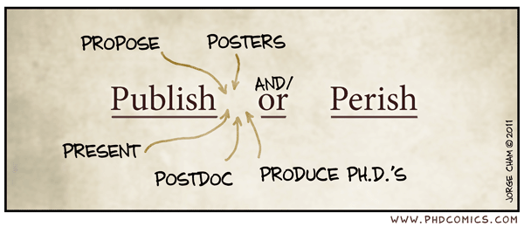
Life in Grad School
Life sucks… at times (marathon anyone?)

Slide 11
Life in Grad School
Conferences become your haven
Life does not stop

Slide 12
Tools of the Trade
Mentors
Colleagues that are just as driven
Mentors
Passions/interest outside of Physics

Slide 13
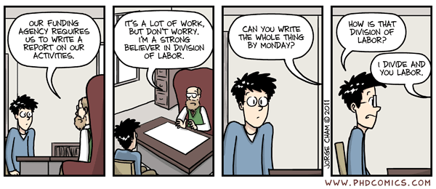
Tools of the Trade
Choose your advisor wisely

Slide 14
Tools of the Trade
Maintain structure
Mentors

Slide 15
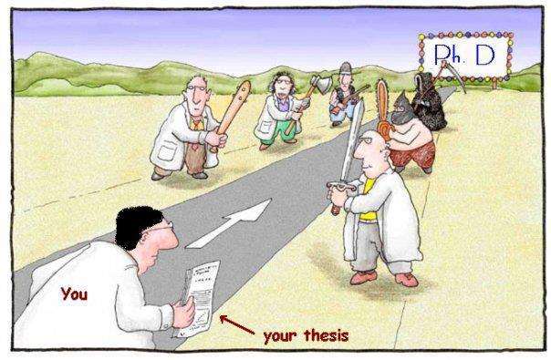
Why Do You Want a PhD in Physics?

